Slide 1
Choosing Your Major
Chapter 2

Slide 2
Job Jar Activity
Introducing the assessments

Slide 3

Making a Career Decision

Slide 4

There is a choice you have to make,
In everything you do.
And you must always keep in mind,
The choice you make, makes you.

Slide 5

Steps in Making a Career Decision
Self-assessment
  Personality, Interests, Values, Skills
Explore options.
Research careers.
Plan your education.
Make a commitment and take action.
Evaluate.
How is it working?

Slide 6

What is Personality Type?

Slide 7

Personality Type
We are born with certain preferences that we develop over a lifetime.
Each person is different and unique just like fingerprints or snowflakes.
Knowing your personal strengths will increase self-understanding and help you make a good choice of a major.

Slide 8
TruTalent Personality Assessment
Use your access code to set up an online portfolio and take this assessment.
Your results are linked to matching careers.

Slide 9
Directions for the Personality Assessment
Find a time when you are not tired or rushed.
There are no right or wrong answers.
Answer quickly giving your first impression. Do not over analyze.
You will have a chance to look at your profile and change it if you think it is not correct.

Slide 10
Directions
Answer the questions honestly to get the best results.
Answer the questions how you usually are when you are not stressed.
Do not answer the questions:
  How you want to be
  How you have to be at home, work or school
  How others want you to be

Slide 11
Important
There are no good or bad types. Each type has personal strengths that can be used in the workplace.
Answer the questions honestly to get the best results. If you don’t answer the questions honestly, the career suggestions will not be a good match for you.

Slide 12
Directions
The test does not measure:
  Intelligence
  Psychological or emotional health
The assessment identifies your personal strengths and matches them to possible careers.

Slide 13
4 Dimensions of Personality Type
Extravert or Introvert
How we interact with the world and
where we place our energy
Sensing or Intuition
The kind of information we naturally
notice and remember
Thinking or Feeling
How we make decisions
Judging or Perceptive
Whether we prefer to live in a structured
or more spontaneous way

Slide 14
Extravert or Introvert
How we interact with the world and where we place our energy
E_____________________________|____________________________I
Extraversion Introversion

Slide 15
Personality and Work Environment
Extraverts
Introverts
Are career generalists
Like variety and action
Are good at communication
Like to talk while working
Learn by talking with others
Like to work as part of a team
Are career specialists
Like quiet for concentration
Think before acting
Prefer written communication
Learn by reading
Prefer working alone

Slide 16
Sample Careers
Extravert
Customer service
Sales
Public relations
Human resources
Physical therapist
Financial advisor
Business management
Introvert
Computer scientist
Software engineer
Scientist
Engineer
Accountant
Graphic designer
Pharmacist
Artist
Notes:
Here are some sample careers matching each type. We can see good opportunities for each type.

Slide 17


Activity: Talkers Vs. Listeners
In the classroom, talkers volunteer to speak and do so frequently. Listeners are people who prefer to stay quiet and rarely join in on the discussions. I want you to identify yourself as a:
Talker or Listener

Slide 18
Group Activity:
Talkers and Listeners
Talker
Listener
What made me a talker?
How can I develop my listening skills?
How can I help listeners talk more?
What made me a listener?
How can I develop my talking skills?
How can I help talkers listen more?

Slide 19
Sensing or Intuitive
The kind of information we naturally notice and remember
S_____________________________|___________________________N
Sensing Intuition

Slide 20
Personality and Work Environment
Sensing
Intuitive
Are realistic and practical
Like standard ways of doing the job
Focus on facts and details
Learn from experience
Like tangible outcomes
Use common sense
Like challenging and complex problems
Like new ways of doing the job
Focus on the big picture
Value creative insight, creativity, imagination and originality

Slide 21
Sample Careers
Sensing
Business executives
Accountants
Police and detectives
Judges
Lawyers
Computer programmers
Doctors and dentists
Interior decorators
Intuitive
Scientists
Engineers
Psychologists
Artists
Photographers
Actors
Professors
Writers
Notes:
Here are some sample occupations for each type. Note that there are good opportunities for each type.

Slide 22
Personality Exercise
Write about the picture for 3 minutes.

Slide 23

Exercise: Sensing or Intuitive
Notes:
Here is an example of what sensing type students have written in the past:
The apple is colored red and yellow. It is round, tasty, and healthy. It smells fresh and tastes good.
If you have a strong preference for sensing, you may have written something similar. Ask for volunteers to share results.
Here is an example of what intuitive student have written:
This apple has made a long journey. Its life began as a seed thrown into a desolate field by a young boy who was enjoying the apple on a summer night.
If you have a strong preference for intuitive, you may have written as creative story about the apple. Ask for volunteers to share results.

Slide 24
Thinking or Feeling
How we make decisions
T_____________________________|___________________________F
Thinking Feeling

Slide 25
Personality and Work Environment
Thinking
Feeling
Use logic to make decisions
Objective and rational
Like to be respected for their expertise
Follow policy
Firm-minded and sometimes critical
Value money, prestige and power
Use personal values to make decisions
Promote harmony
Relate well to others
Enjoy providing service to others
Value careers that make a contribution to humanity

Slide 26
Sample Careers
Thinking
Business managers and administrators
Lawyer
Judge
Computer Specialist
Scientist
Engineers
Mathematicians
Doctors and dentists
Military leaders
Feeling
Childcare workers
Social workers
Counselors
Family practice physicians
Pediatricians
Interior decorators
Photographers
Artists and
musicians
Notes:
Here are some sample careers for each type.

Slide 27
Judging or Perceptive
Whether we prefer to live in a more structured or spontaneous way
J_____________________________|_____________________________P
Judging Perceiving

Slide 28


Personality type
Perceptive
Spontaneous
Judging
Planned and organized

Slide 29
Personality and Work Environment
Judging
Perceptive
Prefer structure and organization
Like to have the work finished
Prefer clear and definite assignments
Like to be spontaneous and go with the flow
Good at dealing with the unplanned and unexpected
Prefer flexible work environments
Stressed by deadlines

Slide 30
Sample Careers
Judging
Business executives
Managers
Accountants
Financial officers
Police and detectives
Judges
Lawyers
Computer programmers
Military leaders
Perceptive
Pilots
Athletes
Paramedics
Police and detective work
Forensic pathologists
Engineers
Scientists
Carpenters
Artists and musicians
Notes:
Here are some sample occupations for each type.

Slide 31
Group Activity: J and P Exercise:
Where do you stand?
  I can play anytime.
  I have to finish my work before I play.

Slide 32

Exploring your Personal Strengths

Slide 33
Your textbook provides an opportunity to explore your multiple intelligences. Use the access code to take the TruTalent Intelligences Assessment.

Slide 34
Multiple Intelligences
Developed by Howard Gardner
Defined as the human ability to solve problems or design or compose things valued in at least one culture
Broadens the scope of human potential

Slide 35
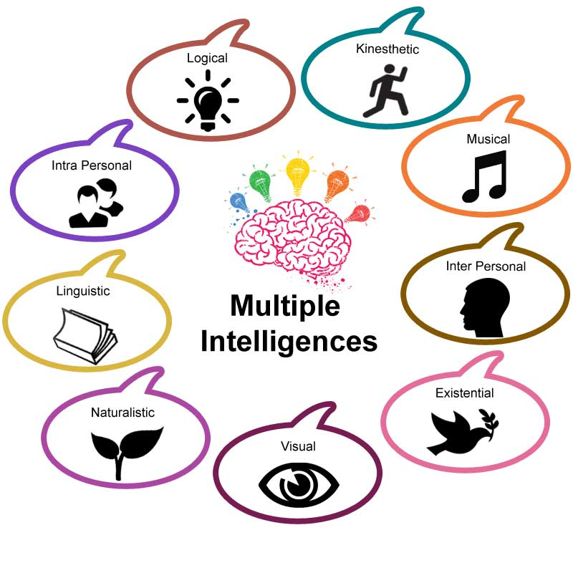
Multiple Intelligences

Slide 36

Build on Your Strengths
Musical
Listening to music
Singing or playing an instrument
Recognizing musical patterns
Musical Smart
Careers
Disc Jockey
Music Teacher
Music Retailer
Music Therapist
Singer
Song Writer
Music Critic
Music Lawyer

Slide 37

Build on Your Strengths
Interpersonal
Communication
Social skills
Helping others
Resolve conflicts
People Smart
Careers
Cruise Director
Mediator
Human Resources
Dental Hygienist
Nurse
Psychologist
Social Worker
Marketer
Counselor

Slide 38
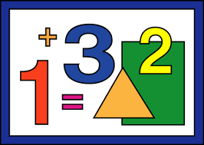
Build on Your Strengths
Logical-Mathematical
Math aptitude
Interest in science
Problem solving
Logical thinking
Number Smart
Careers
Engineer
Accountant
Computer Analyst
Physician
Detective
Researcher
Scientist
Economist

Slide 39
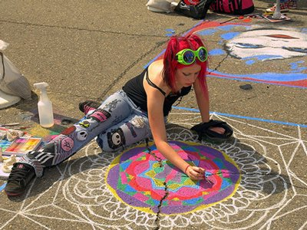
Build on Your Strengths
Spatial
Visualization
Navigation
Reading
Writing
Picture Smart
Careers
Architect
Artist
Film animator
Mechanic
Pilot
Webmaster
Interior decorator
Graphic artist
Photographer

Slide 40
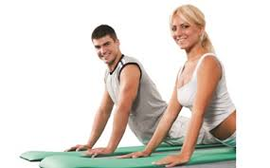
Build on Your Strengths
Bodily- Kinesthetic
Hand and eye
coordination
Athletics
Dance
Drama
Cooking
Learning by doing
Body Smart
Careers
Athlete
Carpenter
Craftsperson
Mechanic
Jeweler
Computer game designer
Firefighter
Forest ranger
Physical therapist

Slide 41

Build on Your Strengths
Linguistic
Reading
Writing
Vocabulary
Spelling
Good listener
Good memory
Word Smart
Careers
Journalist
Writer
Editor
Attorney
Curator
Newscaster
Politician
Librarian
Comedian

Slide 42

Build on Your Strengths
Careers
Career counselor
Wellness counselor Therapist
Criminologist
Intelligence officer
Entrepreneur
Researcher
Actor
Artist
Intrapersonal
Self-aware
Understand
emotions
Independent
Self-motivated
Self Smart

Slide 43
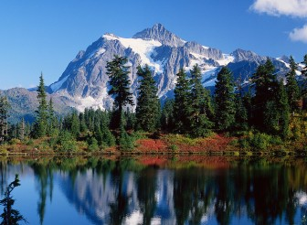
Build on Your Strengths
Naturalist
Aware of natural surroundings
Preserve the environment
Nature Smart
Careers
Park ranger
Dog trainer
Landscaper
Meteorologist
Veterinarian
Animal health technician
Ecologist
Wilderness guide
Environmental lawyer

Slide 44

Build on Your Strengths
Existential
Questioning
Purpose of life
Religious beliefs
Curiosity Smart
Careers
Counselor
Psychologist
Psychiatrist
Social worker
Ministry
Philosopher
Artist
Scientist
Researcher

Slide 45

Emotional Intelligence
Interpersonal + Intrapersonal
The ability to recognize, control, and evaluate your emotions while realizing how they affect other people

Slide 46
Emotional Intelligence
Two Parts:
Understanding yourself, your goals, intentions, responses and behavior
Understanding others and their feelings

Slide 47
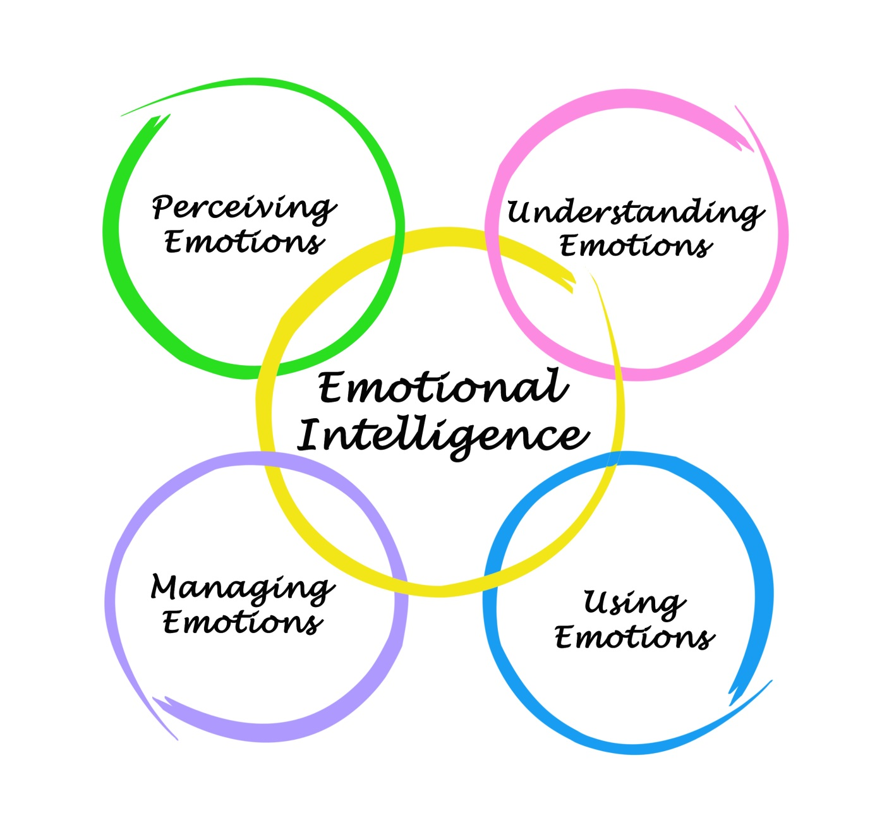
Emotional Intelligence

Slide 48
Emotional Intelligence
Express yourself
Work as part of a team
Concentrate
Remember
Make decisions
Deal with stress
Overcome challenges
Deal with conflict
Empathize with others

Slide 49

How Can You Develop Emotional Intelligence?

Slide 50
Developing Emotional Intelligence
Use empathy.
Think about how your actions affect others.
Be intellectually curious.
Give others credit for their accomplishments.
Work on stress management.
Take a college course on verbal and nonverbal communication.
Take responsibility for your actions.

Slide 51
These intelligences work together in complex ways to make us unique individuals.

Slide 52
Multiple Intelligences Matching Quiz
Michael Jordan
Aristotle
Martin Luther King Jr
Sigmund Freud
William Shakespeare
Albert Einstein
“Will. i am”
Charles Darwin
George Lucas
Musical hearing and remembering musical patterns
Interpersonal: understanding other people
Mathematical: working with numbers
Spatial: manipulating objects in space
Bodily-Kinesthetic: using your body
Linguistic: using language
Intrapersonal: understanding yourself
Naturalist: understanding the environment
Existential: pondering the meaning of life and our place in the universe.

Slide 53

Interests
Knowing your
interests is helpful
in choosing a
major and
career.

Slide 54
The Interest Profiler*
Select the items you might like to do.
You do not need to know how to do them or even have the opportunity to do them.
Don’t select items based on income.
You can earn higher income with more education.
For example, if you would like to build a brick walkway, you could work in construction or with more education, become a civil engineer.
*Take the Interest Profiler at: https://www.mynextmove.org/explore/ip

Slide 55
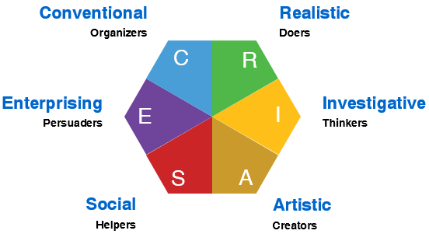
HOLLAND’S HEXAGON

Slide 56
Investigative Persons
Have a strong interest in science
Work with theories, analyze data and solve problems
Are analytical, curious, original and creative
Have good skills in math and science
Are employed in science or lab related work

Slide 57
Artistic Persons
Enjoy visual arts, music, drama or writing
Are creative and value self expression
Work in unstructured and flexible environments
Have artistic talent
Work in museums, theaters, concert halls, advertising

Slide 58
Social Persons
Like to work with people
Enjoy helping, nurturing and caring for others
Have social, communication and teaching skills
Humanistic, idealistic
Work in schools, social services, religious occupations, health care

Slide 59
Enterprising Persons
Like to persuade, lead or supervise
Have skills in selling and communication
Seek positions of leadership, status and power
Employed in business, government, sales and politics

Slide 60
Conventional Persons
Good at organizing and managing details
Like math, accounting, finance
Are efficient and patient
Prefer structure
Work in business, corporations, quality control, and financial institutions

Slide 61
Realistic Persons
Enjoy working with tools, machines, equipment
Often work outdoors
Are active and adventurous
Have good mechanical abilities
Are employed in manufacturing, construction, transportation and engineering

Slide 62
Exploring Your Values

Slide 63

What Are Your Values?

Slide 64

Values are:
What we think is important
What we feel is right and good

Slide 65

Where do we get our values?

Slide 66
Values come from:
Parents
Friends
Culture
Church
Media
Society

Slide 67
Assignment:
My Personal Coat of Arms
What you like about yourself
Your greatest achievement
Your most prized possession
What you value most in life
A symbol of your personality
Three words to be remembered by

Slide 68
Some samples

Slide 69

Example of a Student Coat of Arms

Slide 70

Example of a Student Coat of Arms

Slide 71

Example of a Student Coat of Arms

Slide 72
Complete:
Assessing Your Personal Values
Share your highest value with the class
Complete:
Summing Up Values

Slide 73

Career Trends 2019-2029

Slide 74

Flexibility and Working from home
Teleworking
Using smart phones to do some work at home
Virtual Collaboration
Using Zoom, Skype and other tools
New Media
Required for job success

Slide 75

Diversity
Productivity and profits are increased when a diverse group of people feel appreciated and work together.

Slide 76
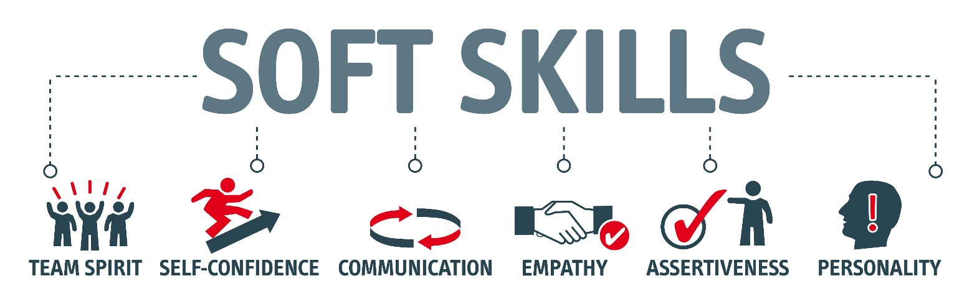
Preference for Soft Skills

Slide 77

Careers of the Future: Business
Finance
Investments
Taxes
Entrepreneurship and small businesses
E-commerce

Slide 78

Globalization
Speak different languages
Study international business

Slide 79

Going Green!
Efficient use of energy
Renewable sources of energy
Preserving the environment

Slide 80

Environmental Science
Conserve water
Control pollution
Manage global warming
Produce food

Slide 81
Energy Shortages
Recycling
Alternative energy
Concerns about global warming and climate change

Slide 82
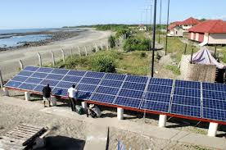

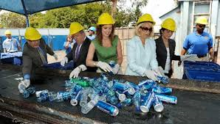
Going Green!
As fossil fuels are depleted, look for more:
  Wind turbines
  Solar panels
  Biofuels
  Emphasis on sustainability
  Taking care of the environment

Slide 83

Green Jobs
Environmental lawyer
Green architect
Sustainability consultant
Marine biologist
Environmental technician
Energy efficiency specialist
Organic farmer
Compliance manager
Product engineer
Wind energy engineer
Solar Engineer

Slide 84

Higher Earnings in STEM Occupations

Slide 85

Research
Engineering
Chemistry
Engineering
Biology
Biotechnology
Requires advanced degrees

Slide 86

Technology
Information and technology workers are the largest group of workers in the U.S.

Slide 87

Mismatch between workers and jobs
More workers needed in scientific and technical fields

Slide 88
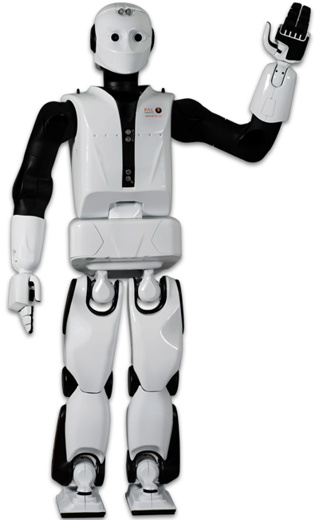
Automation
Robots will do the work
Engineers and technicians will be needed to design and maintain the robots

Slide 89
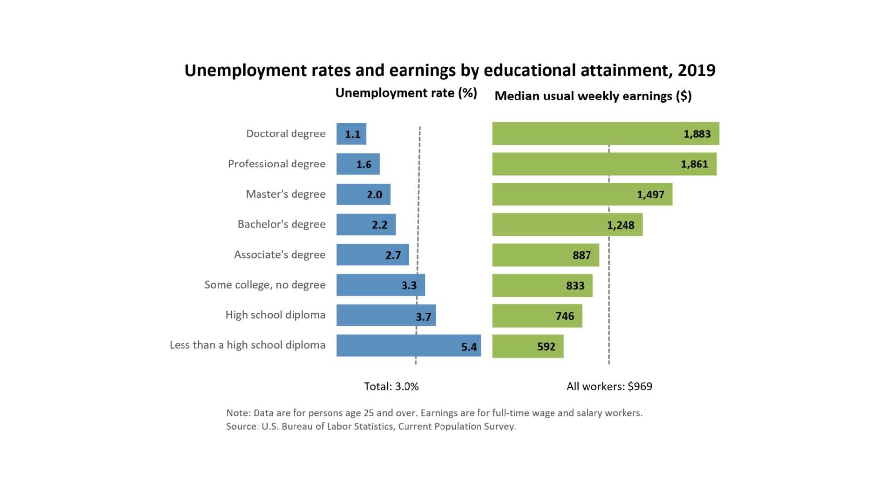
Increased Need for Education

Slide 90
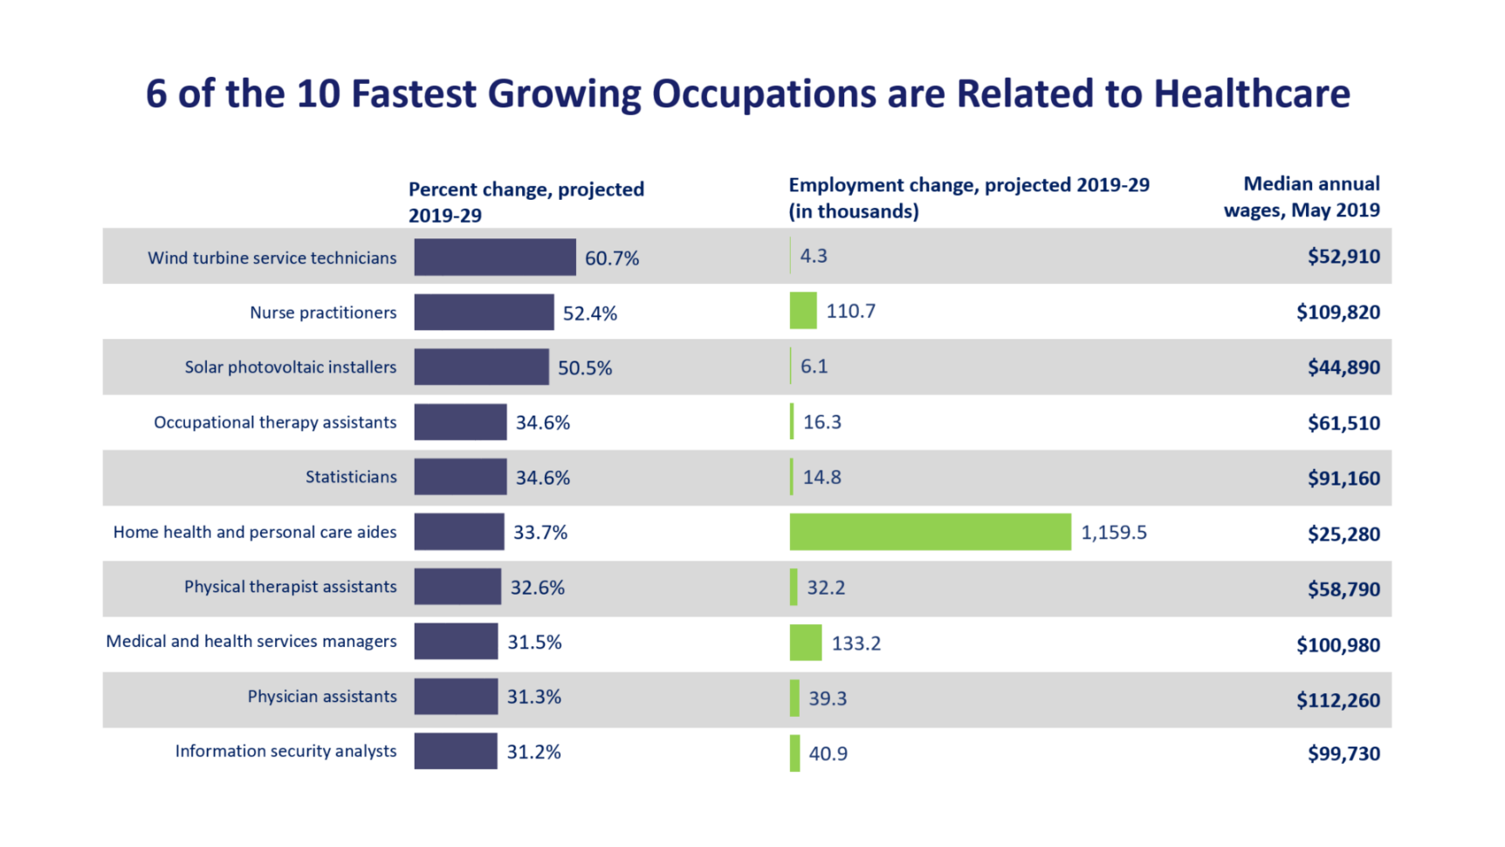
Increasing Opportunities

Slide 91


Largest Numerical Openings
Registered nurses
Home health aides
Customer services rep
Food preparation workers
Personal and home care aides
Retail salespersons
Office clerks
Accountants and auditors
Nursing aides, orderlies
Postsecondary teachers

Slide 92

Increased Opportunities in Healthcare
Most of the new jobs will be in healthcare.

Slide 93
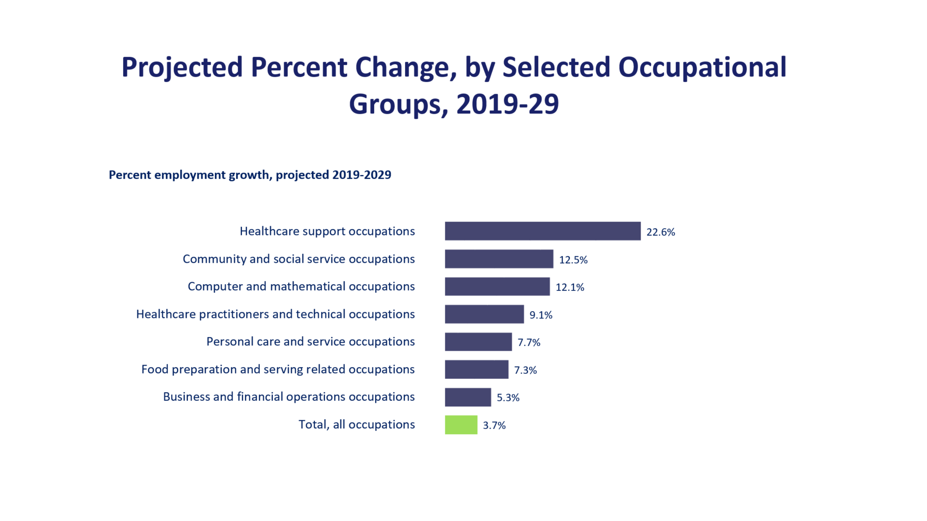
Employment Growth

Slide 94

Service Occupations in Demand
Health Care
Business
Education
Finance
Insurance
Real Estate
Transportation
Communication

Slide 95

Mental Health
Because of increasing violence, we are starting to realize the importance of mental health

Slide 96

Artificial Intelligence
Enables computers to approximate human thought

Slide 97

Teaching
As older teachers retire, there will be an increasing need for teachers.

Slide 98

Security
Law enforcement
Intelligence
Forensics
International relations
Foreign affairs
Security administration

Slide 99

The TruTalent Skills Assessment
Rate Your Skills for Success
In the workplace

Slide 100

Other Factors in Choosing a Major

Slide 101


Career Research
Once your have completed the assessments, you may have several job options to consider.
          Research the job outlook to find out which jobs will be available and how much they pay.
Some students may opt for lower
Paying jobs that serve humanity
and provide personal fulfillment.

Slide 102

Top Jobs for the Future
Business
Education
Entertainment
Health
Information Technology
Travel/Transportation
Law/Law enforcement
Services
Sports and related
Technology
Trades

Slide 103
10 Highest Salary Increase
Management Scientific, Technical
Physicians
Computer Systems design
General merchandise stores
Employment Services
Local government
Home health care services
Services for elderly and disabled
Nursing care facilities
Full-service restaurants

Slide 104
10 Fastest Growing
Biomedical engineer
Network systems and data communications analyst
Home health aides
Personal and home care aides
Financial examiners
Medical scientists
Physician assistants
Skin care specialists
Biochemists and biophysicists
Athletic Trainers

Slide 105
10 Highest Salary Increase
Management Scientific, Technical
Physicians
Computer Systems design
General merchandise stores
Employment Services
Local government
Home health care services
Services for elderly and disabled
Nursing care facilities
Full-service restaurants

Slide 106
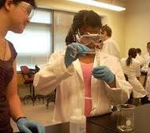

Top Paying Jobs
Require math and science
Petroleum Engineering
Electrical Engineering
Accounting
Electrical engineering
Chemical Engineering
Aerospace engineering
Bioengineering
Statistics
Computer science
Civil engineering
Nursing
Environmental engineering
Construction management
Physics
Economics

Slide 107
Largest Numerical Openings
Registered nurses
Home health aides
Customer services rep
Food preparation workers
Personal and home care aides
Retail salespersons
Office clerks
Accountants and auditors
Nursing aides, orderlies
Postsecondary teachers

Slide 108

Checklist for a Satisfying Career

Slide 109
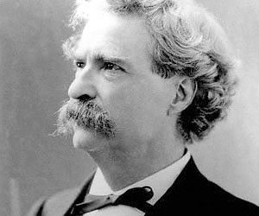
Keys to Success: Find Your Passion
The secret of success is making your vocation your vacation.
Mark Twain

Slide 110
Keys to Success: Find Your Passion
3 Types of Work:
A job (what you do for a paycheck)
A career (personally meaningful work)
A calling (a passionate commitment)
Martin Seligman says that you know you have found a calling when you are in the stare of flow. He defines flow as:
a complete absorption in an activity whole challenges mesh perfectly with your abilities.

